Slide 1
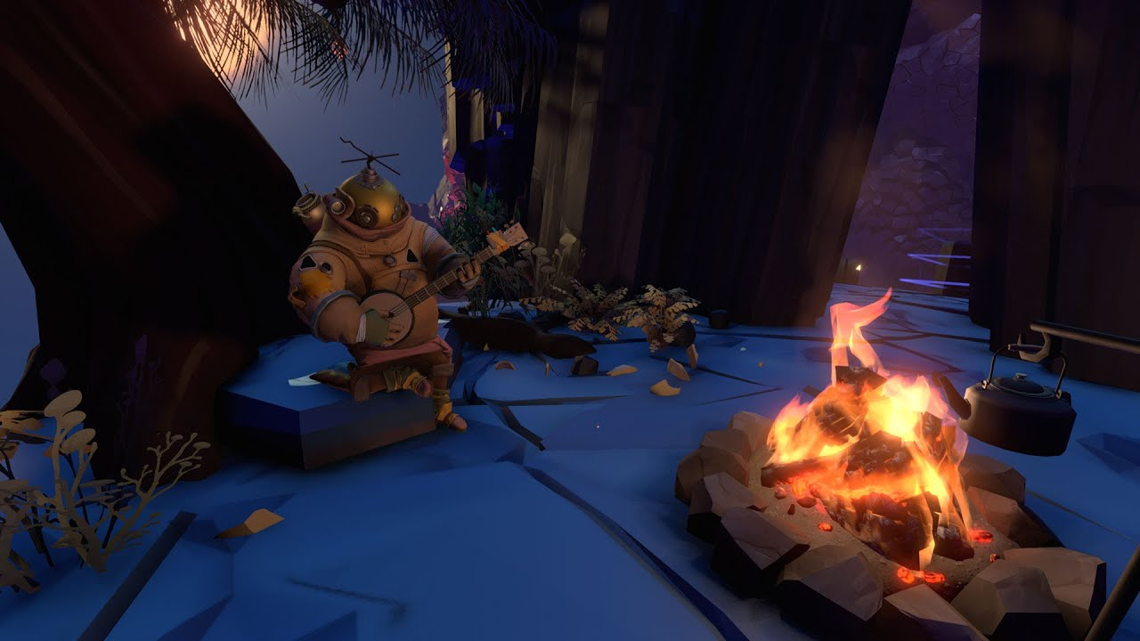
Class 7
User Interfaces and Skeletal Animation

Slide 2
Introduction
User Interfaces

Slide 3
Many shades of UI
Heads-up display (HUD)
Persistent 2D elements drawn over the game
Ex. your health & resources, minimap, available actions/cooldowns
Orthographic UI
2D elements drawn in the 3D scene
Ex. entity health bars, tips, popup dialog, 2D special effects
Usually doesn’t scale with camera distance
Separate screens/overlays
Inventory, menus, shops, dialog

Slide 4
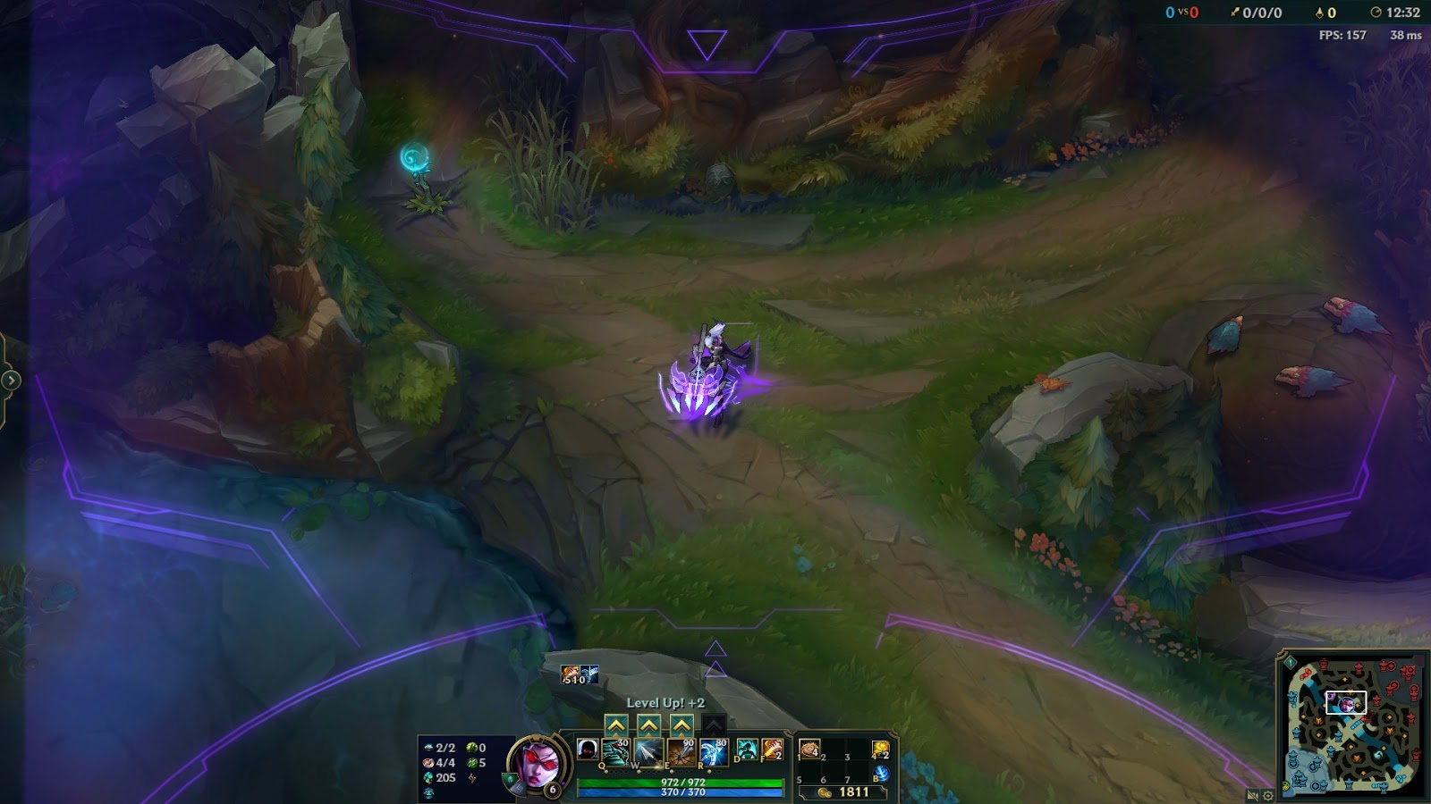
Heads-Up Display
Game stats (KDA, fps)
Player health & abilities (most important)
Minimap
HUD
(League of Legends)
Player stats & inventory
Notes:
-note how most of the screen space is the actual game
-each different type of information is separated out into very distinct areas of the screen with space between,
so you can easily say ‘I want to look at the minimap’ and just look down-right, or ‘I want to see my abilities’ and you look down-center.

Slide 5
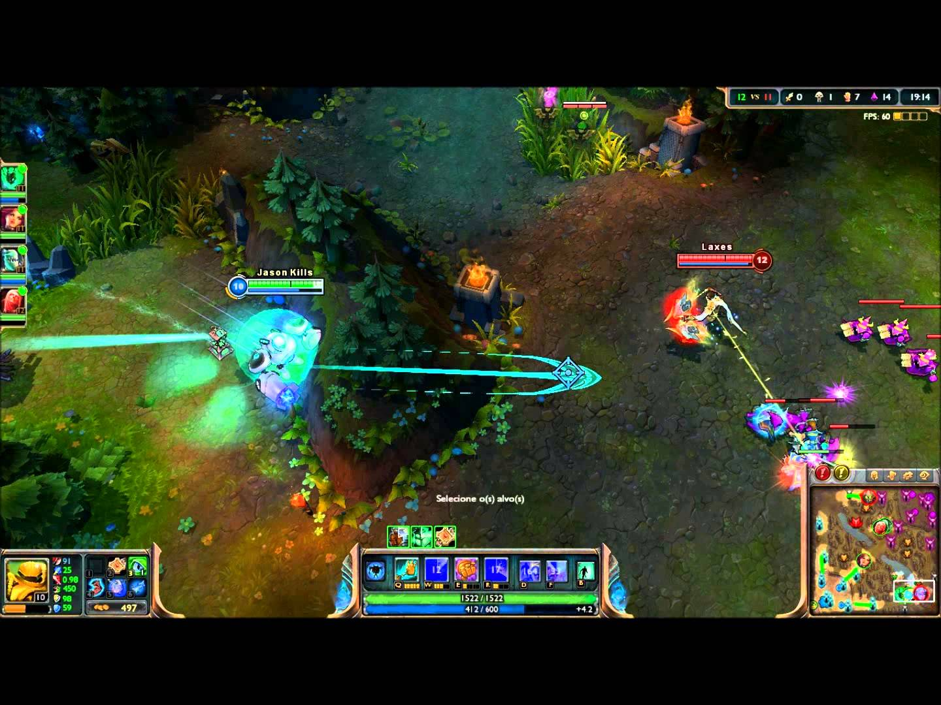
HUD Clarity
The HUD takes up minimal screen space
Each different type of information is placed in a distinct and isolated area of the screen
Notes:
-note how most of the screen space is the actual game
-each different type of information is separated out into very distinct areas of the screen with space between,
so you can easily say ‘I want to look at the minimap’ and just look down-right, or ‘I want to see my abilities’ and you look down-center.

Slide 6
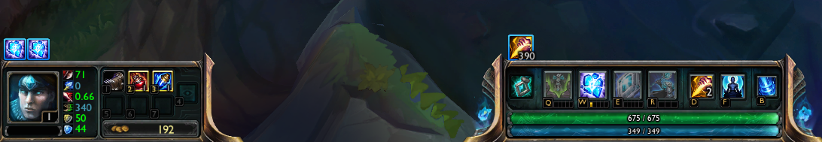
HUD Clarity
Deciding where to put information (and how to group it) is very important
‘Battle’ effects go here
‘Other’ effects go here

Slide 7
Drawing HUD
Use the built in m_camera->setUI(true) so that your draw calls act in screen space
Draw things over your game!

Slide 8
Orthographic
User Interfaces

Slide 9
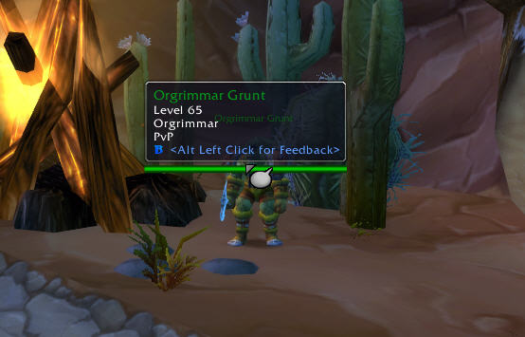
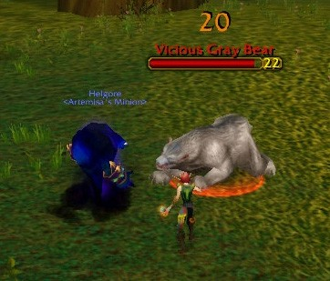
Orthographic UI
Tooltips
Health bars & Damage

Slide 10
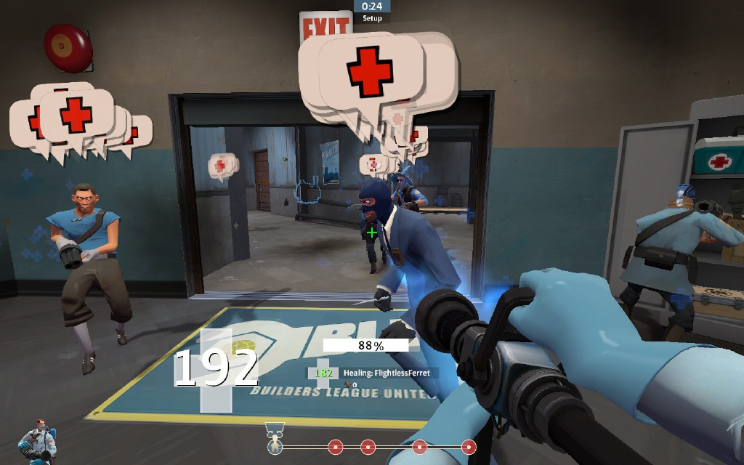
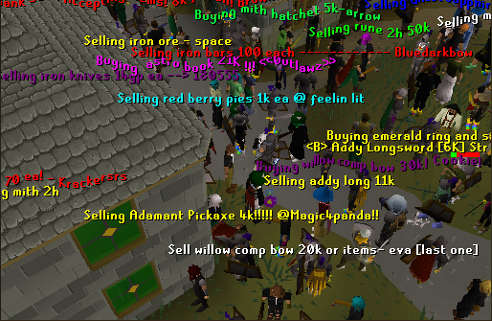
Orthographic UI
“MEDIC!”
(Team Fortress 2)
Dialog
(Runescape)

Slide 11
How to Orthographic UI
Goal: draw orthographic UI next to / above an entity within your game
Approach
Figure out screen space position of the object you want to draw
Figure out if the game object is in front of or behind the camera
Draw orthographic UI at that location (same way to draw HUD)
(25, 200)

Slide 12
Converting to screen space
vec3 convertToScreenSpace(vec3 pos, vec2 screenSize) {
// get these from your camera
mat4x4 view, projection;
// this is necessary for the matrix multiplication
vec4 fourVec = vec4(pos.x, pos.y, pos.z, 1.f);
// project the position into clip space
fourVec = projection * view * fourVec;
// x and y range from -1 to 1
vec3 clipSpace = vec3(fourVec.x / fourVec.w, fourVec.y / fourVec.w,
fourVec.z);
// convert x and y to pixel coordinates, leave z alone
return vec3((clipSpace.x + 1) * .5f * screenSize.x,
(1 - clipSpace.y) * .5f * screenSize.y, clipSpace.z);
}
Notes:
* Has to do with homogenous coordinates (test this out beforehand with another project)

Slide 13
Using the projected position
Use the x and y components of the vector calculated in the previous slide to position draw calls on the screen
If the z-component is less than 0, it means that the object is behind the camera
In other words, don’t draw it!
If it’s greater than 0, draw the UI!
If you want your orthographic UI elements to be occluded by objects in the world, make sure the OpenGL depth test is turned on
When you use a UI camera, the stencil turns off the depth test by default

Slide 14
Engine Integration
Users Interfaces

Slide 15
How to integrate UI?
Recommended:
GameWorld has a UISystem with UIComponents.
Tell your UISystem to draw after drawing all the other components
If an orthographic UI component requires some game logic, have it belong to (and have a reference to) a GameObject.
Notes:
Don’t encourage making new event for every shader
Separate event so UI is on top of everything, different shader

Slide 16
Your UI
You are required to implement some use of orthographic UI and HUDs this week
Try to think of something unique and interesting to your game concept!
E.g. inventory, health bars

Slide 17
More UI
Some UI is related to GameWorld
In game pop-ups, shopkeeper menus, etc.
Some UI isn’t
Settings menu, pause menu, etc.
It’s okay to handle these differently

Slide 18
More UI
Common elements
Buttons
Text
Should be implemented engine-side

Slide 19
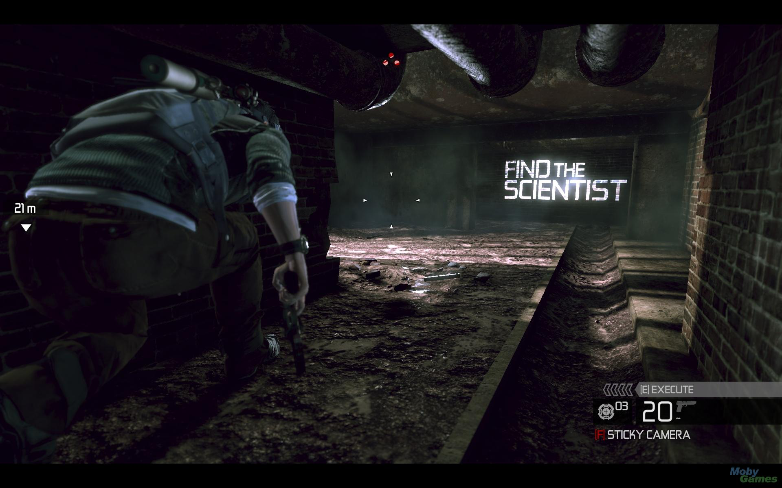
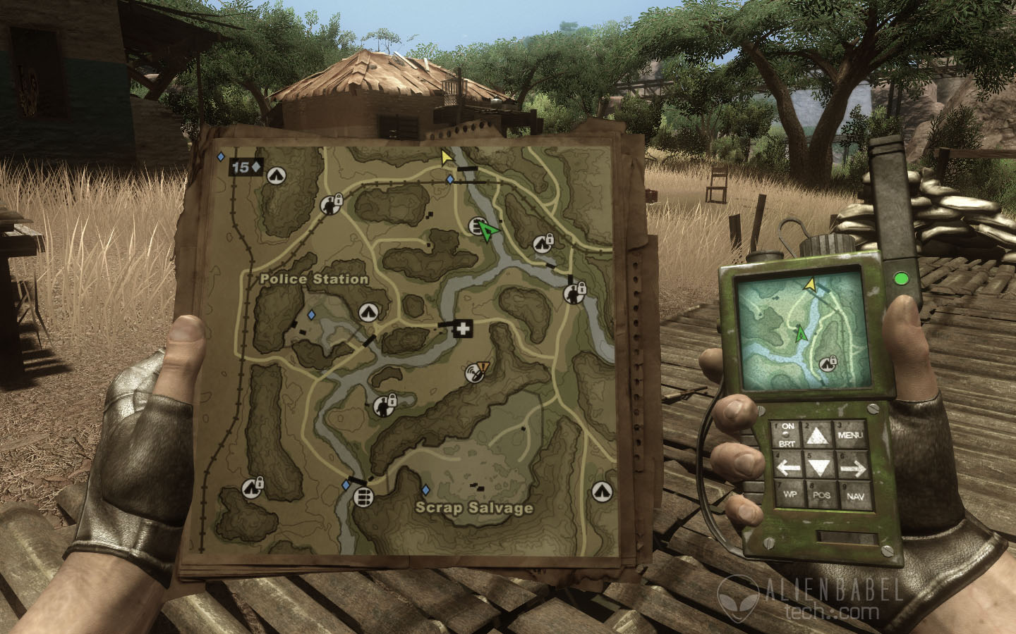
3D-Integrated UI
Instructions
(Splinter Cell)
Minimap
(Far Cry 2)

Slide 20
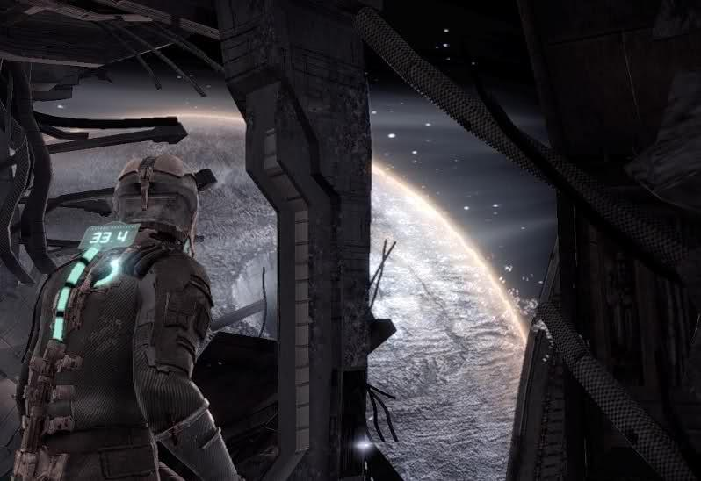
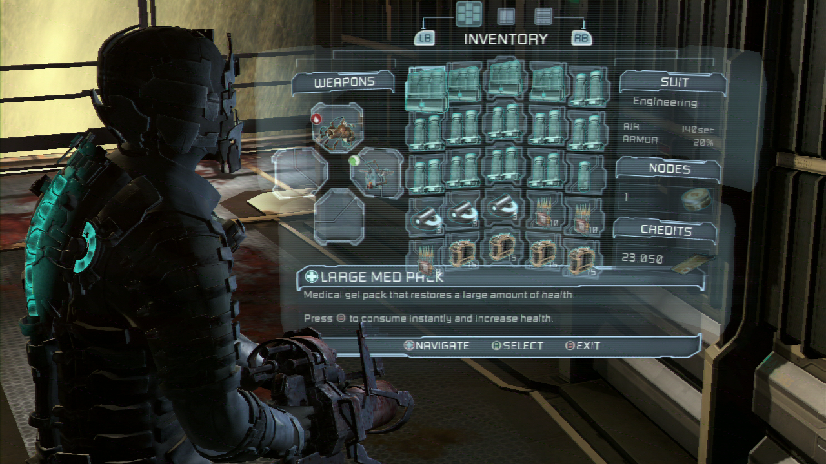
3D-Integrated UI
All user interfaces as in-game holograms
(Dead Space)

Slide 21
Questions?
User Interfaces

Slide 22
Class 7
Skeletal Animation

Slide 23
Skeletal Animation (From a high Level)

Slide 24
Skeletal Animation
How can we animate meshes in our game engines?
We will need some method of moving vertices at each tick
But storing the position of each vertex in the mesh for each frame of the animation would be expensive

Slide 25
Skeletal Animation
The method of skeletal animation uses a “skeleton” of joints that control the positions of the vertices (i.e. ”the skin”)
We can store the pose of the skeleton at each frame, and then use the skeleton to compute the vertex positions

Slide 26
The Skeleton
1
2
3
4
0

Slide 27
The Skeleton
A skeleton is a hierarchy of nodes called “joints”
A joint has a position and an orientation that can change at each tick
Here, the red (x) and green (y) axes represent each joint’s orientation (i.e. the local coordinate system of each joint)
More on skeletons later…

Slide 28
Joint Weights
But how does the skeleton control the mesh?
Each joint has a certain constant influence on each vertex, usually called a “weight”
If the weight of joint j on vertex v is 1.0, then j completely controls v
If the weight is 0, then j has no influence on v
If the weight is between 0 and 1.0, then v is influenced by joint j and by other joints as well

Slide 29
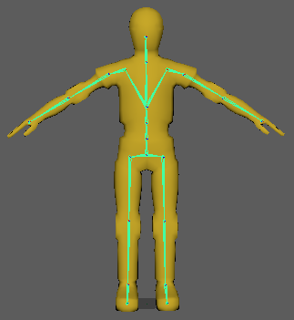
Skinning
We define the joint weights in a process called “skinning”
First, we take the mesh in the “bind pose” (for a character, this is usually a T-pose)
Next, we take the skeleton (also in the bind pose)
Let the joint weight of joint j for vertex v be w_{ij}
We can use many different methods to calculate the joint weights, but in general, if vertex v is far away from joint j, then w_{ij} is small or 0
If vertex v is close to joint j, then w_{ij} will be close to 1.0

Slide 30
Animation
Now we have a mesh bound to a skeleton, and we know the influence that each joint has on each vertex of the mesh
We can think of an ”animation” as a sequence of poses of the skeleton
Using the skeleton’s bind pose, the skeleton’s animated pose, and the joint weights, we can calculate the position of each vertex for each frame of the animation

Slide 31
The Skeleton

Slide 32
Defining the Skeleton
Remember that a skeleton is a hierarchy of joints
Each joint can have an arbitrary number of children, and each joint has a parent joint
In this class, we will define the position and orientation of each joint j using a rotation R and translation T in the coordinate system of j’s parent
We will call these types of transforms ”joint-space transforms”
What does that mean?

Slide 33
Defining the Skeleton
1
Consider joint 1
The parent of joint 1 is the origin in the object space of the mesh
2
3
4
0

Slide 34
Defining the Skeleton
Starting at the origin…
1
0

Slide 35
Defining the Skeleton
We can rotate joint 1 about 20 degrees clockwise (in the parent’s coordinate system)…
1
0

Slide 36
Defining the Skeleton
And then translate the joint -3 units in the x direction +2 units in the y direction (in the parent’s coordinate system)
1
2 units
3 units

Slide 37
Defining the Skeleton
Let’s look at another example
1

Slide 38
Defining the Skeleton
Joint 2 starts at its parent (with the same position and orientation)
2

Slide 39
Defining the Skeleton
Then we rotate joint 2 170 degrees clockwise (in the parent’s coordinate system)
2

Slide 40
Defining the Skeleton
Then we translate +2 units in the x direction (in the parent’s coordinate system)
1
2 units
2

Slide 41
Defining the Skeleton
Here are the joint-space transforms for joints 3 and 4
Rotation: 10 degrees clockwise
Translation: (-2,0)
1
2
3
Rotation: 170 degrees clockwise
Translation: (+1,+2)
4
0

Slide 42
Defining the Skeleton
The skeleton’s bind pose and its poses in an animation are defined using joint-space transforms
The joint space transform is represented as a 4x4 matrix (joint_space_transform = translation * rotation)

Slide 43
Calculating Animated Vertices

Slide 44
Animating Vertices
Given the joint space transforms of a skeleton’s bind pose p_{b}, the joint space transforms of an animation pose p_{a}, and the vertex positions of the mesh in p_{b}, we can calculate the vertex positions of the mesh in p_{a}
In the following slides, we will make a simplifying assumption: Each vertex is influenced by exactly one joint
We will get rid of this simplification soon

Slide 45
Animating Vertices
If each vertex is influenced by exactly one joint, then the position of vertex v relative to its influencing joint j should be constant, no matter what pose the skeleton is in
Think of a point on your forearm
It is influenced completely by the position and orientation of your elbow, and it stays at a constant position relative to your elbow’s position and orientation
Bind Pose
Animation Pose

Slide 46
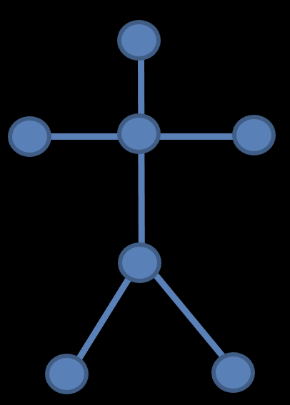
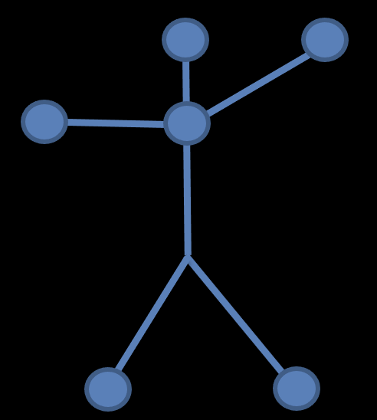
Animating Vertices
Vertex v, x_{v, anim}
We are given the coordinates of vertex v in the bind pose (call them x_{v, bind})
We will first calculate the coordinates of v in the joint-space of the influencing joint j (Call these coordinates x_{v,j})
From the previous slide, we know x_{v,j} will not change when the pose changes
Next, we will convert x_{v,j} to coordinates in object space, when joint j is in pose p_{a} (call them x_{v, anim})
Vertex v, x_{v, j}
Vertex v, x_{v, bind}
Influencing joint j
Influencing joint j
0
Influencing joint j
0
0
STEP 1 (Object space, bind pose)
STEP 2 (Joint space)
STEP 3 (Object space, animated pose)

Slide 47
Animating Vertices
We are given step 1, so how do we get to step 2?
Let P(j) be the parent of joint j
Let S_{j} be the joint-space bind pose transformation matrix of joint j
Define T_{root} = S_{root}, the object space bind pose transformation matrix of the root joint in the skeleton
Define T_{j} = T_{P(j)}S_{j}, the object space bind pose transformation matrix of joint j
Vertex v, x_{v, bind}
Vertex v, x_{v, j}
Influencing joint j
0
Influencing joint j
0
STEP 1 (Object space, bind pose)
STEP 2 (Joint space)

Slide 48
Animating Vertices
Define T_{j} = T_{P(j)}S_{j}, the object space bind pose transformation matrix of joint j
Using the fact that S_{j} is a rotation followed by a translation (slide 21), we can show that T_{j} takes a point in the joint-space of joint j and outputs the same point in object space with the skeleton is in the bind pose
So, we can take the inverse of T_{j}, which will take a point in object space with the skeleton in the bind pose and output the same point in the joint-space of joint j
inverse(T_{j}) is called the “inverse bind transform” for joint j
X_{v, j} = inverse(T_{j}) * x_{v, bind}
So, step 2 is complete!
Vertex v, x_{v, bind}
Vertex v, x_{v, j}
Influencing joint j
0
Influencing joint j
0
STEP 1 (Object space, bind pose)
STEP 2 (Joint space)

Slide 49
Animating Vertices
Vertex v, x_{v, anim}
How do we go from step 2 to step 3?
Remember we are just dealing with a single frame of animation here
Let P_{j} be the joint-space animated pose transformation matrix of joint j
Define A_{root} = P_{root}, the object space animated pose transformation matrix of the root joint in the skeleton
Define A_{j} = A_{P(j)}P_{j}, the object space animated pose transformation matrix of joint j
Vertex v, x_{v, j}
0
Influencing joint j
0
STEP 2 (Joint space)
STEP 3 (Object space, animated pose)

Slide 50
Animating Vertices
Vertex v, x_{v, anim}
Define A_{j} = A_{P(j)}P_{j}, the object space animated pose transformation matrix of joint j
Just as T_{j} takes a point in the joint-space of joint j and outputs the same point in object space with the skeleton in the bind pose…
A_{j} takes a point in the joint-space of joint j and outputs the same point in object space with the skeleton in the animated pose
Vertex v, x_{v, j}
0
Influencing joint j
0
STEP 2 (Joint space)
STEP 3 (Object space, animated pose)

Slide 51
Animating Vertices
Now we know how to animate vertices!
Take the position of vertex v in the bind pose: x_{v, bind}
Remember v is ony influenced by joint j
Then, the vertex position in the animated pose is…
Vertex v, x_{v, j}
Vertex v, x_{v, anim}
Vertex v, x_{v, bind}
Influencing joint j
0
Influencing joint j
x_{v, anim} = A_{j}T_{j}x_{v, bind}
0
0
STEP 1 (Object space, bind pose)
STEP 2 (Joint space)
STEP 3 (Object space, animated pose)

Slide 52
Animating Vertices
Vertex v, x_{v, j}
Vertex v, x_{v, anim}
Vertex v, x_{v, bind}
Influencing joint j
0
T_{j}
A_{j}
Influencing joint j
0
0
STEP 1 (Object space, bind pose)
STEP 2 (Joint space)
STEP 3 (Object space, animated pose)

Slide 53

Animating Vertices
But how do we deal with vertices influenced by multiple joints?
Let j₁,…,j_{n} be the influencing joints on joint v, and let w₁,…,w_{n} be the corresponding weights
Then we just take a weighted average
x_{v, anim} = $∑$w_{i}A_{i}T_{i}x_{v, bind}

Slide 54
Extra details

Slide 55
Interpolating Frames
A tick will not necessarily take place right at the instant a frame of the animation is supposed to take place!
We can save space by defining fewer frames in an animation
What do we do if the tick doesn’t occur at the instant of the frame?
We need to interpolate two frames

Slide 56
Interpolating Frames
If the current tick occurs between frames f₀ and f₁ (at a time between t₀ and t₁), then we need to produce interpolated frame data
f_{interp}= interpolate(f₀, f₁, t₀/(t₁ – t₀))
To get f_{interp}, we need to interpolate the rotation and translation information of f₀ and f₁

Slide 57
Interpolating Translation Data
To linearly interpolate the translation data, all we need to do is take x_{interp}= x₀ + (x₁ – x₀) * t₀/(t₁ – t₀), where x₀ is the translation data from frame f₀ and x₁ is the translation data from frame f₁

Slide 58
Interpolating Rotation Data
To linearly interpolate the rotation data, we can’t just perform traditional interpolation on the rotation matrices
We need to represent the rotation data of the frames as unit quaternions
Quaternions are 4-element vectors that represent a rotation about an axis
Rotation by θ about N = (x, y, z) gives a quaternion of (cos(θ/2), x sin(θ/2), y sin(θ/2), z sin(θ/2))
We perform spherical linear interpolation (SLERP) on the quaternion representation

Slide 59
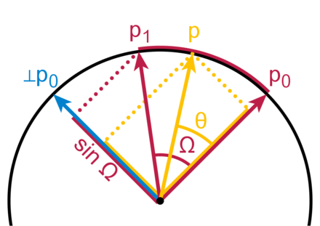
SLERP
The SLERP algorithm interpolates the quaternions over the 4D hypersphere
If we linearly interpolated the quaternions as we do with translations, we would not necessarily end up with a unit quaternion
You are free to use glm::mix, which works on glm::quat

Slide 60
Animation Files
There are many different ways to store animation files
COLLADA (.dae)
FBX (.fbx)
and more

Slide 61
WARNING!
Implementing skeletal animation can be an enormous time sink because the files that store the animation are very complicated and can work in unintuitive ways!
It can also be difficult to export multiple animations for the same model in one file
Using a parsing library will save you some time, but you will probably still have to learn the details of the file type you are using

Slide 62
WARNING!
Implementing skeletal animation can be an enormous time sink because the files that store the animation are very complicated and can work in unintuitive ways!
It can also be difficult to export multiple animations for the same model in one file
Using a parsing library will save you some time, but you will probably still have to learn the details of the file type you are using

Slide 63
WARNING!
If you want to implement skeletal animation, you should probably use COLLADA files because they are easier to understand compared to FBX files

Slide 64
Advanced Animation

Slide 65
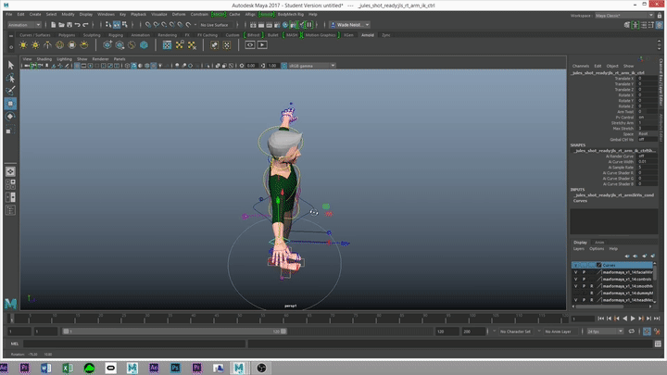
Inverse Kinematics
“Forward kinematics” is the process of positioning the joints of a skeleton from the root to the leaves of the hierarchy
“Inverse kinematics” is the process of positioning the end of a limb (like a foot or a hand) and automatically solving for the positions of the joints that result in the

Slide 66
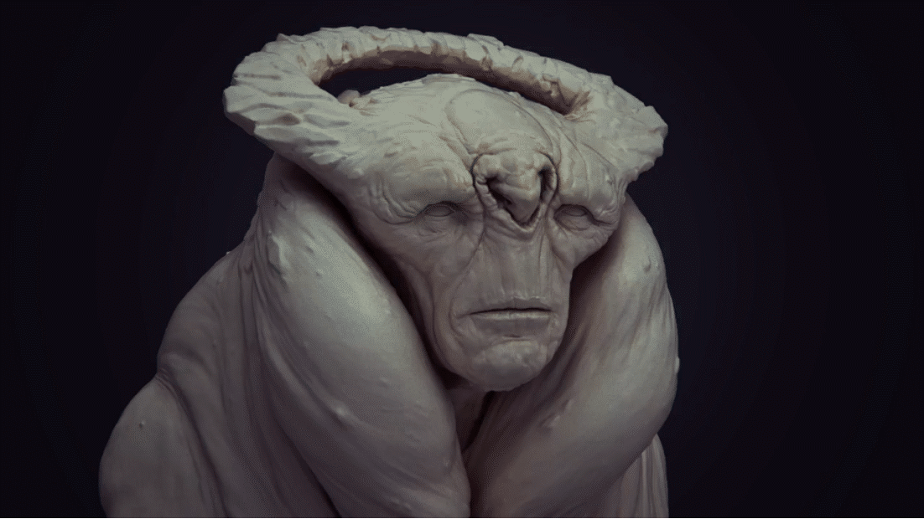
Blend Shapes
Simpler than skeletal animation!
We have a start and end position for each vertex, and we just interpolate between those two positions
Useful for animating faces

Slide 67
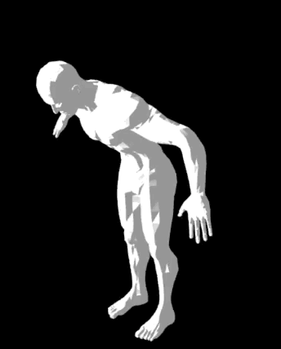
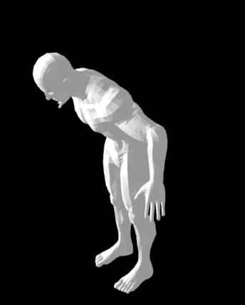
Dual Quaternion Blending
We have discussed “linear blend skinning”
Unfortunately, this type of skinning can result in non-rigid transformations
These occur because we add up rigid transformations in our vertex shader, but rotation matrices are not closed under addition!
“Dual quaternion skinning” takes the same weights, rotations, and translations we use in linear blend skinning and produces final vertex transformations that are rigid
Fortunately, upgrading from linear blend skinning to dual quaternion skinning is easy!
Just convert your matrices to dual quaternions before sending them to the vertex shader, and then modify your vertex shader to properly blend the dual quaternions
Check out “Skinning with Dual Quaternions” by Kavan et al. for details!
Linear Blend
Dual Quaternion

Slide 68
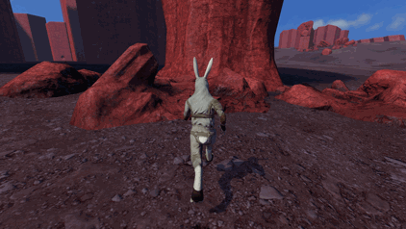
Ragdoll Physics
Simulate parts of a character as constrained rigid bodies

Slide 69
Class 7
Good luck on Platformer 4!

